Slide 1


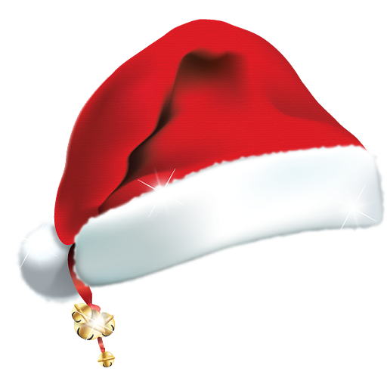
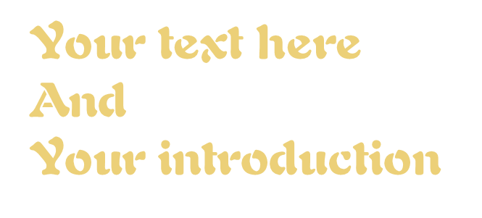
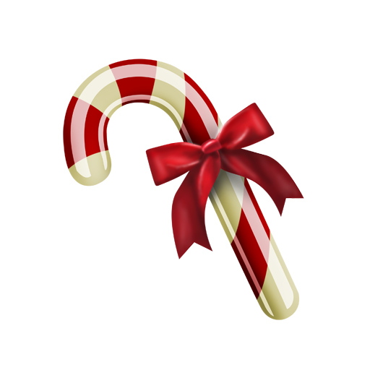

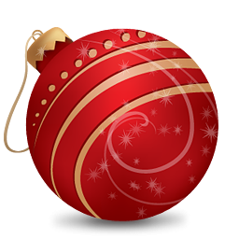

NumeralJingle
Where Numbers Spark a Christmas Countdown Extravaganza!
Vasile Mihaela Alina-121 IEC

Slide 2
Octal Ornaments
Binary Bells
part1
part3
Introduction
Decimal Delight
part2
part4

Slide 3
Cultural Christmas Carnival
part5
part7
Conclusions
Hexadecimal Holly
The Numerical North Pole
part6
part8

Slide 4
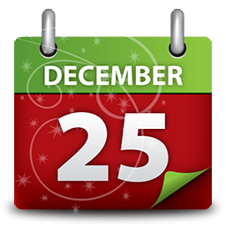
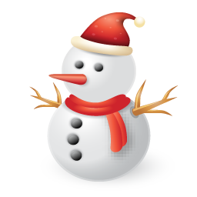
introduction
Step into the magical wonderland of NumeralJingle, the ultimate Christmas-themed numerical extravaganza!

Slide 5
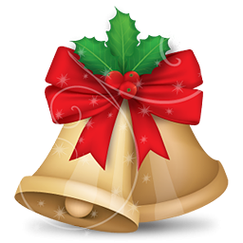
Get ready for a festive journey through numeral systems, where numbers trade their calculators for jingle bells. Join the party where digits jingle, salsa, and reindeer-hop through a numerical adventure like never before!

Slide 6
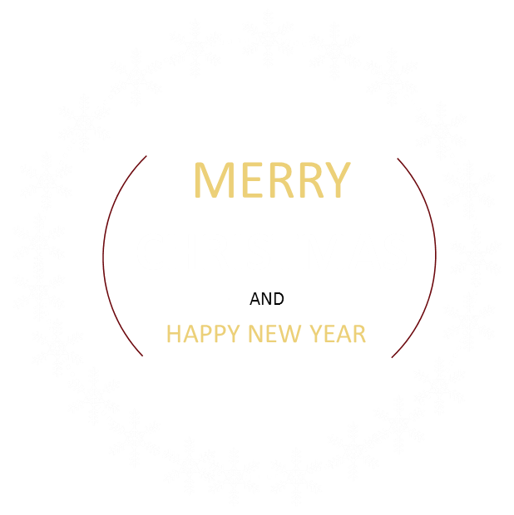

Binary Bells
Ring in the festivities with the Binary Bells, where 0s and 1s twirl as dance partners. Did you know that the ballet of binary code is inspired by ancient holiday magic? It's not just coding; it's a Binary Bells celebration that transforms computers into the holiday dancefloor of the future!

Slide 7
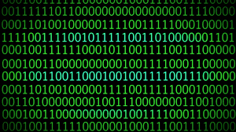
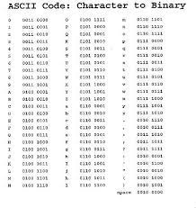
Binary Bells
In computer science and mathematics, binary is a system where numbers and values are expressed 0 or 1. Binary is base-2, meaning that it only uses two digits or bits. For computers, 1 is true or "on", and 0 is false or "off". The concept of binary and bits are based on of Boolean Algebra.
And things like ASCII work with binary under the hood.
In fact, while computers work with all sorts of different input and output, at their core, they work entirely with binary.
https://www.freecodecamp.org/news/binary-definition/
https://www.youtube.com/watch?v=AkFi90lZmXA&t=40s

Slide 8

Decimal Delight
Switch gears to the Decimal Delight, where perfect tens rule the snow-covered dance floor. Ever pondered why we're all about the perfect ten? Thank your lucky digits; those ten fingers make decimals the stars of our holiday arithmetic delight.

Slide 9
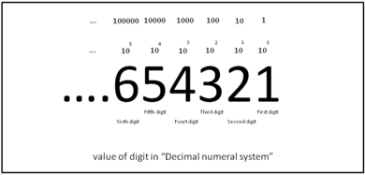
Decimal Delight
https://www.britannica.com/science/decimal
https://en.wikipedia.org/wiki/Decimal
This number system, with its associated arithmetic algorithms, has furnished the basis for the development of Western commerce and science since its introduction to the West in the 12th century CE.

Slide 10


Octal Ornaments
Often overlooked in the festive lineup, octal representation takes center stage as a clandestine language among Santa's elves. Within the intricate workings of the North Pole's workshop, octal emerges as a numerical enchantment, casting magical spells on festive permissions.

Slide 11
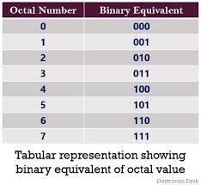
Octal Ornaments
The word octal is used to represent the numbers that have eight as the base. The octal numbers have many applications and importance such as it is used in computers and digital numbering systems.
https://www.cuemath.com/numbers/octal-number-system/

Slide 12
Hexadecimal Holly
In the same festive light, Hexadecimal Holly invites us to explore the numerical winter wonderland with an alphabetic twist. The hexadecimal system, with its utilization of the alphabet from A to F, transforms into an intricate dance of symbolism and functionality.

Slide 13
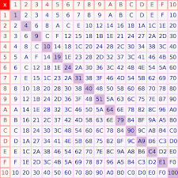
Hexadecimal Holly
https://byjus.com/maths/hexadecimal-number-system/
https://en.wikipedia.org/wiki/Hexadecimal
The hexadecimal number system is a type of number system, that has a base value equal to 16. It is also pronounced sometimes as ‘hex’. Hexadecimal numbers are represented by only 16 symbols.

Slide 14
Cultural Christmas Carnival
Join the Cultural Christmas Carnival where the Mayans throw a base-20 snowball fight, counting on fingers and toes after a night of celestial festivities.

Slide 15
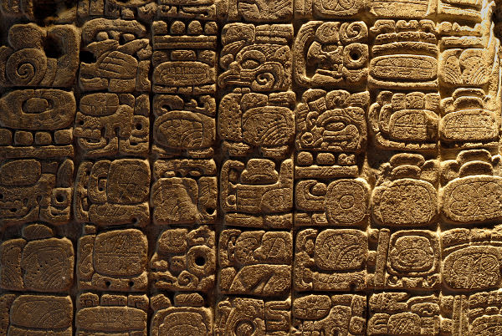
Cultural Christmas Carnival
Mayan numerical prowess wasn't confined to calculation alone. Elaborate murals in Mayan archaeological sites depict intricate mathematical concepts. The glyphs and symbols showcase a deep understanding of numerical relationships, revealing the Mayans' passion for integrating math into their artistic expressions.

Slide 16
The Numerical North Pole
As an interlude, explore the whimsical side of numerical phenomena at the North Pole—a realm where Santa's elves engage in factorial mathematics, hot cocoa cups pose marshmallow counting challenges, and every snowflake becomes a unique numerical masterpiece.

Slide 17
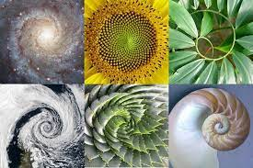
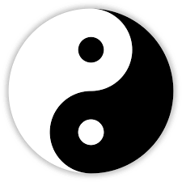
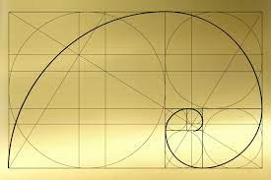
Fun facts
The golden ratio, an irrational number approximately equal to 1.618, appears in diverse aspects of art and architecture. From the Parthenon in Greece to the Mona Lisa's proportions, this numerical harmony captivates the human eye, revealing the universal appeal of mathematical ratios in aesthetics.
Binary code, the language of computers, finds its roots in ancient Chinese philosophy. The principles of yin and yang, representing the duality of existence, inspired the binary system's use of 0s and 1s. This philosophical dance laid the groundwork for the digital age.

Slide 18
Conclusion
In the gentle descent of snowflakes, conclude this academic expedition through Jingle Digits.Embrace the profundity of numbers, dance through the numerical wonderland, and allow the festive digits to guide you into the heart of a season enriched by mathematical merriment.

Slide 19

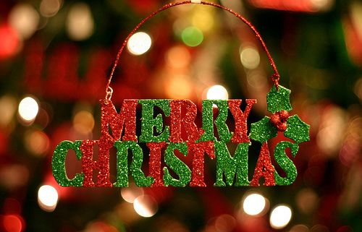
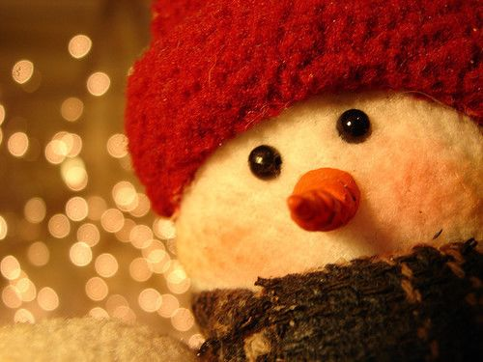
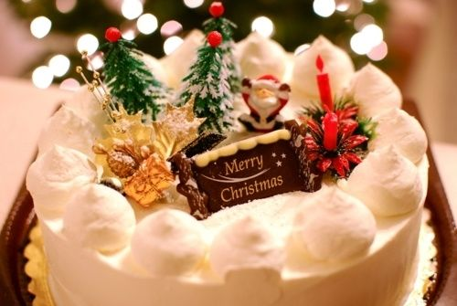
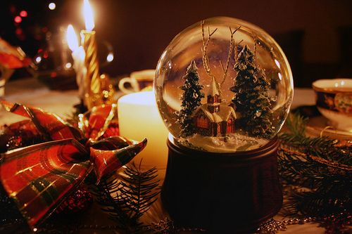
MERRY
CHRISTMAS

